Slide 1
Event Management System
Director by SAHIL KUMAR NAYAK
Notes:
Hello Friends i am SAHIL KUMAR NAYAK and in this presentation i will present a java project name EVENT MANAGEMENT SYSTEM

Slide 2
LET START
Notes:
i will discuss about technologies used for this project an overview of the project and all the functions one by one

Slide 3
QUICK VIEW
DISCUSS ABOUT TECHNOLOGIES USED TO DEVELOPED THIS PROJECT
Notes:
first of all i will discuss about the technologies used to developed this project

Slide 4
TECHNOLOGIES / LANGUAGES
Notes:
so to develop

Slide 5
TECHNOLOGIES / LANGUAGES
FRONT END
Notes:
front end

Slide 6
TECHNOLOGIES / LANGUAGES
FRONT END
Notes:
i have used

Slide 7
TECHNOLOGIES / LANGUAGES
FRONT END
ANGULAR
Notes:
angular,

Slide 8
TECHNOLOGIES / LANGUAGES
FRONT END
ANGULAR
BOOTSTRAP
Notes:
bootstrap,

Slide 9
TECHNOLOGIES / LANGUAGES
FRONT END
ANGULAR
BOOTSTRAP
HTML
Notes:
html

Slide 10
TECHNOLOGIES / LANGUAGES
FRONT END
ANGULAR
BOOTSTRAP
HTML
CSS
Notes:
and css

Slide 11
TECHNOLOGIES / LANGUAGES
FRONT END
BACK END
ANGULAR
BOOTSTRAP
HTML
CSS
Notes:
for back end

Slide 12
TECHNOLOGIES / LANGUAGES
FRONT END
BACK END
ANGULAR
BOOTSTRAP
HTML
CSS
Notes:
i have used

Slide 13
TECHNOLOGIES / LANGUAGES
FRONT END
BACK END
ANGULAR
BOOTSTRAP
HTML
CSS
SPRING BOOT
Notes:
spring boot,

Slide 14
TECHNOLOGIES / LANGUAGES
FRONT END
BACK END
ANGULAR
BOOTSTRAP
HTML
CSS
SPRING BOOT
SPRING JPA
Notes:
spring jpa

Slide 15
TECHNOLOGIES / LANGUAGES
FRONT END
BACK END
ANGULAR
BOOTSTRAP
HTML
CSS
SPRING BOOT
SPRING JPA
JAVA
Notes:
and java

Slide 16
TECHNOLOGIES / LANGUAGES
FRONT END
BACK END
DATABASE
ANGULAR
BOOTSTRAP
HTML
CSS
SPRING BOOT
SPRING JPA
JAVA
Notes:
and

Slide 17
TECHNOLOGIES / LANGUAGES
FRONT END
BACK END
DATABASE
ANGULAR
BOOTSTRAP
HTML
CSS
SPRING BOOT
SPRING JPA
JAVA
Notes:
mysql is used as a database

Slide 18
TECHNOLOGIES / LANGUAGES
FRONT END
BACK END
DATABASE
ANGULAR
BOOTSTRAP
HTML
CSS
SPRING BOOT
SPRING JPA
JAVA
MYSQL
Notes:
mysql is used as a database

Slide 19
OVERVIEW
Notes:
now let's take an overview of a project

Slide 20
OVERVIEW
USER
Notes:
here in this project we have mainly three roles first one is user

Slide 21
OVERVIEW
USER
ORGANIZER
Notes:
second is organizer

Slide 22
OVERVIEW
USER
ORGANIZER
ADMIN
Notes:
and at last admin

Slide 23
OVERVIEW
USER
ORGANIZER
ADMIN
Notes:
so now let me talk about the various Functionalities which are developed according to these roles

Slide 24
OVERVIEW
USER
BOOK EVENT
Notes:
user will able to book event online on various menus

Slide 25
OVERVIEW
USER
BOOK EVENT
VIEW VENUES
Notes:
after that he will be able to see all the venues available on the portal

Slide 26
OVERVIEW
USER
BOOK EVENT
VIEW VENUES
VIEW VENUES DETAILS
Notes:
user can see new details which consist of equipment food items and various events

Slide 27
OVERVIEW
USER
BOOK EVENT
VIEW VENUES
VIEW VENUES DETAILS
BOOKING HISTORY
Notes:
user will also be able to see his or her booking history

Slide 28
OVERVIEW
USER
BOOK EVENT
VIEW VENUES
VIEW VENUES DETAILS
BOOKING HISTORY
VIEW NOTIFICATIONS
Notes:
Notifications

Slide 29
OVERVIEW
USER
BOOK EVENT
VIEW VENUES
VIEW VENUES DETAILS
BOOKING HISTORY
VIEW NOTIFICATIONS
VIEW PROFILE
Notes:
and profile

Slide 30
OVERVIEW
USER
ORGANIZER
BOOK EVENT
VIEW VENUES
VIEW VENUES DETAILS
BOOKING HISTORY
VIEW NOTIFICATIONS
VIEW PROFILE
Notes:
after user our second role is organizer

Slide 31
OVERVIEW
USER
ORGANIZER
BOOK EVENT
VIEW VENUES
VIEW VENUES DETAILS
BOOKING HISTORY
VIEW NOTIFICATIONS
VIEW PROFILE
Notes:
after user our second role is organizer

Slide 32
OVERVIEW
USER
ORGANIZER
BOOK EVENT
VIEW VENUES
VIEW VENUES DETAILS
BOOKING HISTORY
VIEW NOTIFICATIONS
VIEW PROFILE
ADD VENUE
Notes:
so organizer can add new venue to the portal

Slide 33
OVERVIEW
USER
ORGANIZER
BOOK EVENT
VIEW VENUES
VIEW VENUES DETAILS
BOOKING HISTORY
VIEW NOTIFICATIONS
VIEW PROFILE
ADD VENUE
MANAGE VENUE
Notes:
Manage all venues that means update or delete present menus

Slide 34
OVERVIEW
USER
ORGANIZER
BOOK EVENT
VIEW VENUES
VIEW VENUES DETAILS
BOOKING HISTORY
VIEW NOTIFICATIONS
VIEW PROFILE
ADD VENUE
MANAGE VENUE
VIEW BOOKINGS
Notes:
organizer can see upcoming and paid bookings

Slide 35
OVERVIEW
USER
ORGANIZER
BOOK EVENT
VIEW VENUES
VIEW VENUES DETAILS
BOOKING HISTORY
VIEW NOTIFICATIONS
VIEW PROFILE
ADD VENUE
MANAGE VENUE
VIEW BOOKINGS
BOOKING HISTORY
Notes:
made on his or her respective venue also can be able to see booking history similar to the user

Slide 36
OVERVIEW
USER
ORGANIZER
BOOK EVENT
VIEW VENUES
VIEW VENUES DETAILS
BOOKING HISTORY
VIEW NOTIFICATIONS
VIEW PROFILE
ADD VENUE
MANAGE VENUE
VIEW BOOKINGS
BOOKING HISTORY
VIEW NOTIFICATIONS
Notes:
Organizer will also be able to see notifications

Slide 37
OVERVIEW
USER
ORGANIZER
BOOK EVENT
VIEW VENUES
VIEW VENUES DETAILS
BOOKING HISTORY
VIEW NOTIFICATIONS
VIEW PROFILE
ADD VENUE
MANAGE VENUE
VIEW BOOKINGS
BOOKING HISTORY
VIEW NOTIFICATIONS
VIEW PROFILE
Notes:
and profile

Slide 38
OVERVIEW
USER
ORGANIZER
ADMIN
BOOK EVENT
VIEW VENUES
VIEW VENUES DETAILS
BOOKING HISTORY
VIEW NOTIFICATIONS
VIEW PROFILE
ADD VENUE
MANAGE VENUE
VIEW BOOKINGS
BOOKING HISTORY
VIEW NOTIFICATIONS
VIEW PROFILE
Notes:
the third role is admin

Slide 39
OVERVIEW
USER
ORGANIZER
ADMIN
BOOK EVENT
VIEW VENUES
VIEW VENUES DETAILS
BOOKING HISTORY
VIEW NOTIFICATIONS
VIEW PROFILE
ADD VENUE
MANAGE VENUE
VIEW BOOKINGS
BOOKING HISTORY
VIEW NOTIFICATIONS
VIEW PROFILE
Notes:
so admin is considered as the owner of this application

Slide 40
OVERVIEW
USER
ORGANIZER
ADMIN
BOOK EVENT
VIEW VENUES
VIEW VENUES DETAILS
BOOKING HISTORY
VIEW NOTIFICATIONS
VIEW PROFILE
ADD VENUE
MANAGE VENUE
VIEW BOOKINGS
BOOKING HISTORY
VIEW NOTIFICATIONS
VIEW PROFILE
VIEW BOOKING
Notes:
and will able to perform some functions such as

Slide 41
OVERVIEW
USER
ORGANIZER
ADMIN
BOOK EVENT
VIEW VENUES
VIEW VENUES DETAILS
BOOKING HISTORY
VIEW NOTIFICATIONS
VIEW PROFILE
ADD VENUE
MANAGE VENUE
VIEW BOOKINGS
BOOKING HISTORY
VIEW NOTIFICATIONS
VIEW PROFILE
VIEW BOOKING
VIEW VENUES
Notes:
he can view all bookings when news user

Slide 42
OVERVIEW
USER
ORGANIZER
ADMIN
BOOK EVENT
VIEW VENUES
VIEW VENUES DETAILS
BOOKING HISTORY
VIEW NOTIFICATIONS
VIEW PROFILE
ADD VENUE
MANAGE VENUE
VIEW BOOKINGS
BOOKING HISTORY
VIEW NOTIFICATIONS
VIEW PROFILE
VIEW BOOKING
VIEW VENUES
VIEW USERS
Notes:
and organizers registered on the portal

Slide 43
OVERVIEW
USER
ORGANIZER
ADMIN
BOOK EVENT
VIEW VENUES
VIEW VENUES DETAILS
BOOKING HISTORY
VIEW NOTIFICATIONS
VIEW PROFILE
ADD VENUE
MANAGE VENUE
VIEW BOOKINGS
BOOKING HISTORY
VIEW NOTIFICATIONS
VIEW PROFILE
VIEW BOOKING
VIEW VENUES
VIEW USERS
VIEW ORGANIZERS
Notes:
so this was the just quick overview of the project

Slide 44
ACTUAL PROJECT SCREENSHOT
Notes:
i will move towards our actual project screenshot

Slide 45
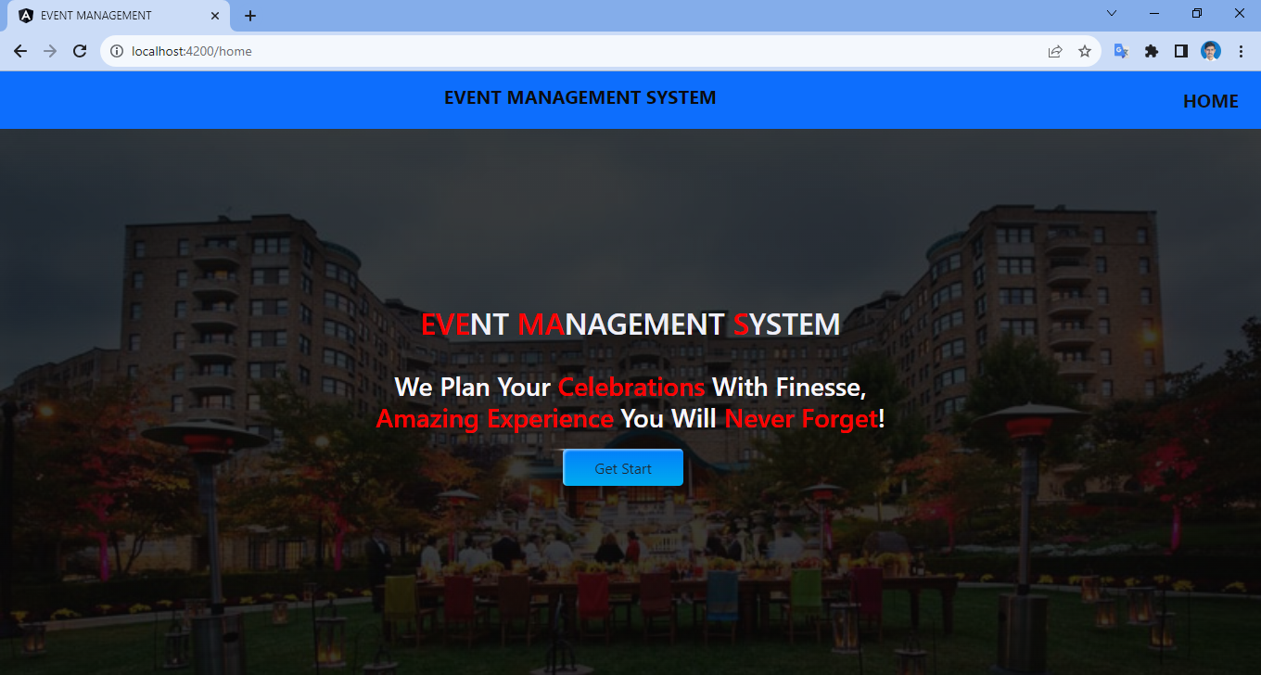
Notes:
so this is the home page of the application. The navbar is at the top which shows the title of the project – event management system and home button. As you can see the get start button is in the center of the page. By clicking on it we will be redirected to the login page .

Slide 46
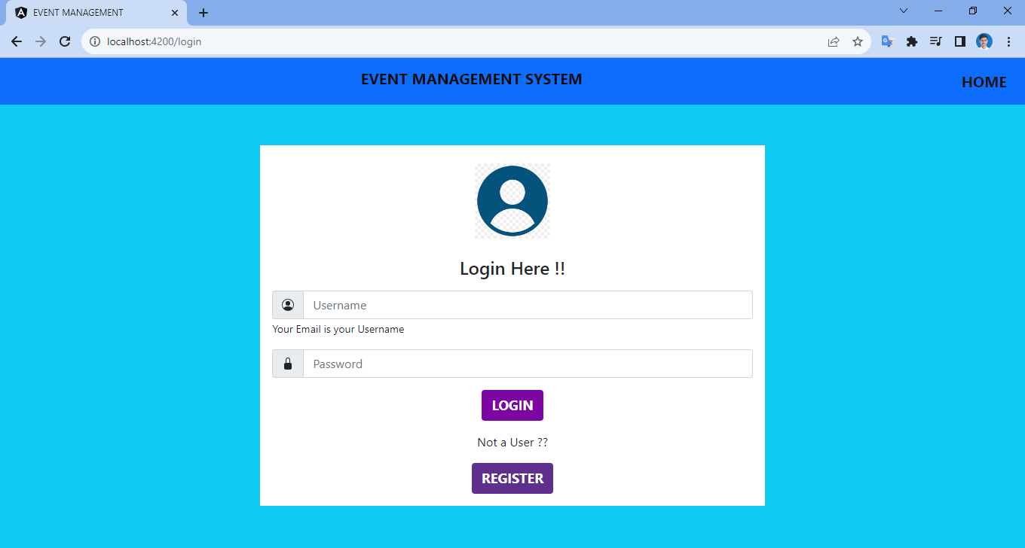
Notes:
So here we can see two fields the username and password. If you are already a registered user you can simply fill up your user details or register by clicking on the register button after which you will be redirected to the registration page . If there is a mistake while filling up the details an error message will be displayed. Also by clicking on the home button on the top right corner you will be redirected back to home page .

Slide 47
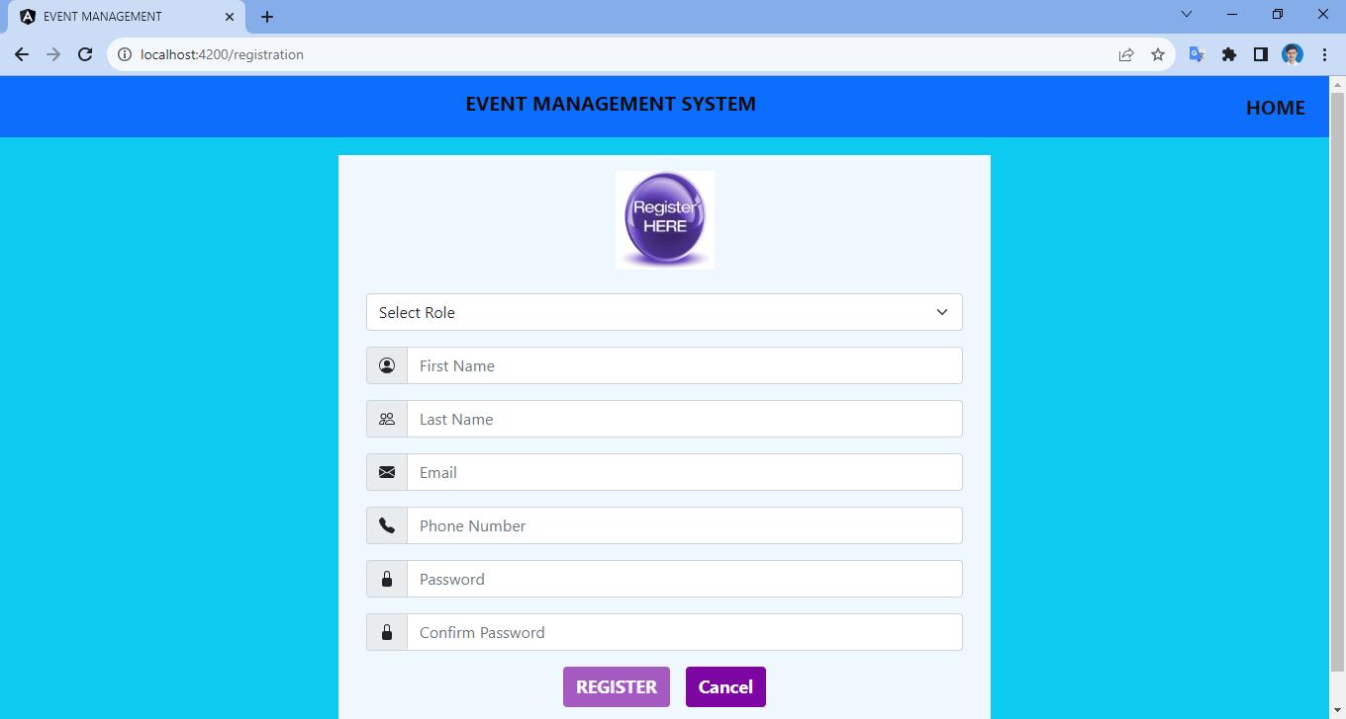
Notes:
On the registration page you have to select your role as an user or organizer, admin can store his or her details manually in the data base. After this you can simply fill up your respective details.

Slide 48
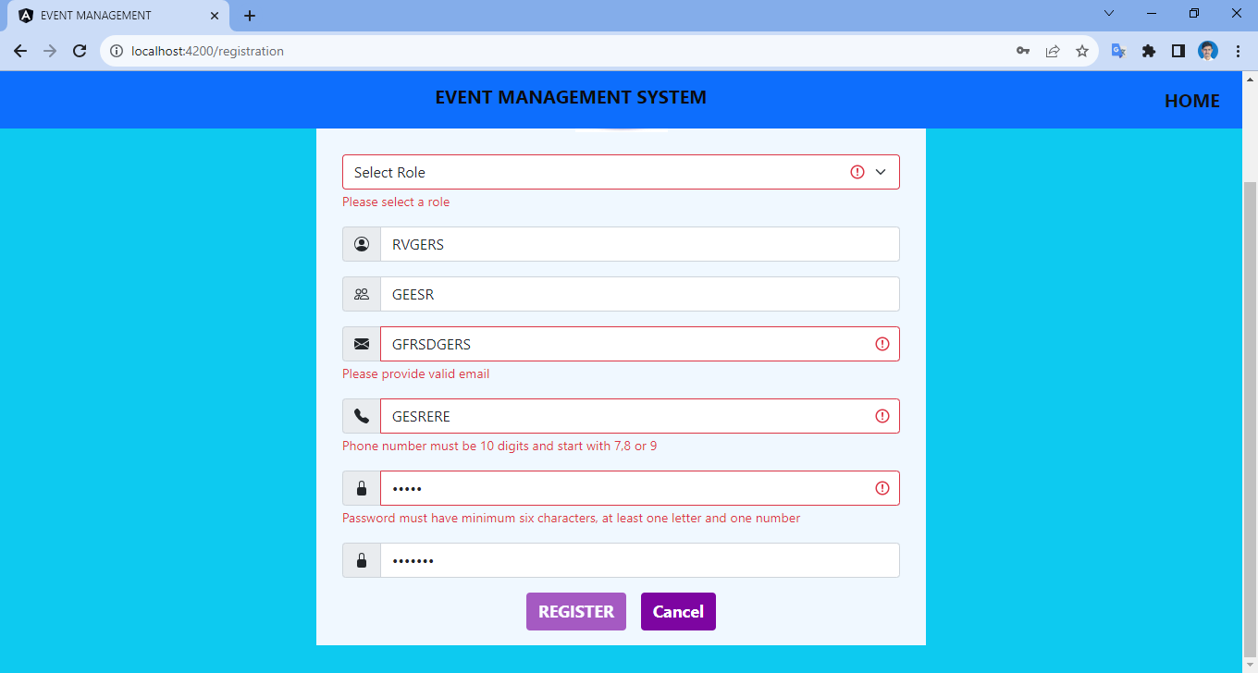
Notes:
If you fill up any wrong details for example if the password and confirm password field do not match or you leave any field empty an error message will be displayed. Also the register button will be disabled. by the way i have added one where The phone number can only start from 7 8 9.

Slide 49
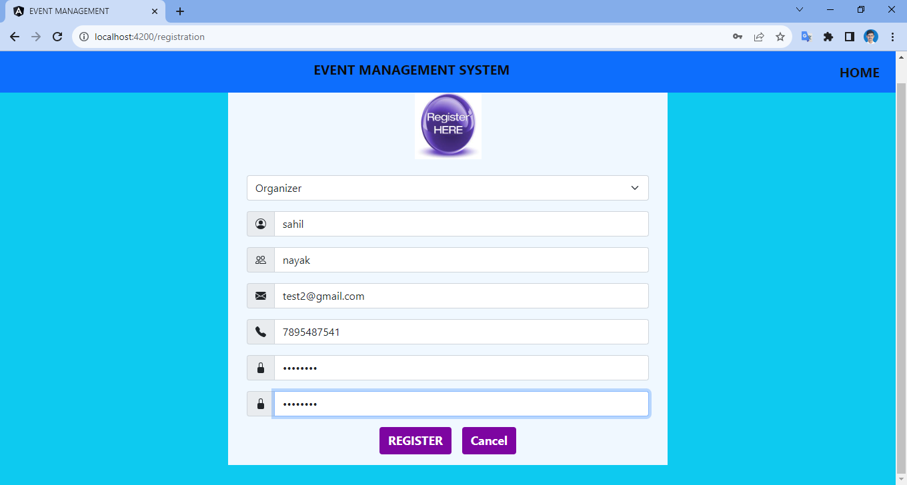
Notes:
So as I have filled all my details correctly including my password the register button is enabled.

Slide 50
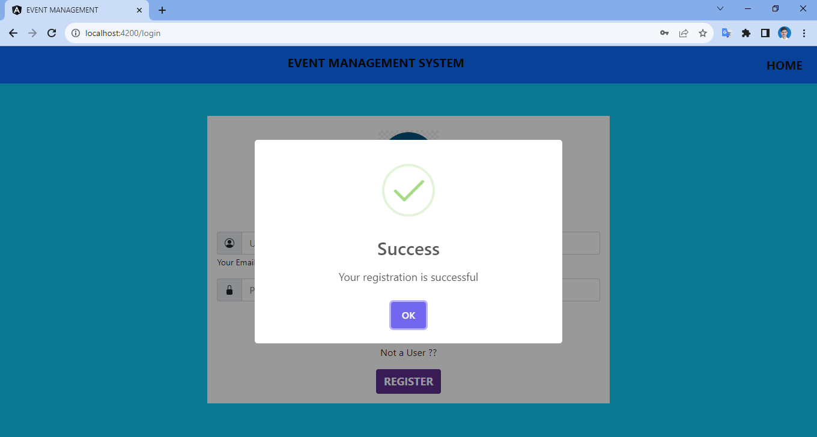
Notes:
and now my registration is successful and i am redirected to the login page automatically

Slide 51
Notes:
But what if i try to click on login button without entering anything in these fields or fill up any wrong details

Slide 52
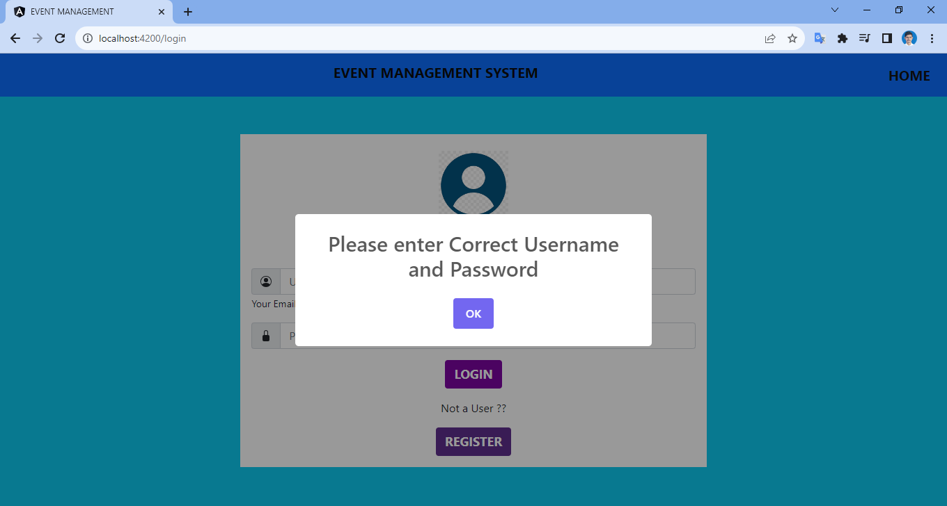
Notes:
we got a pop-up saying please enter correct username and password same thing will happen if i enter any wrong username or password now this time i will enter correct password and try to login and by clicking login button we have successfully logged into our application and landed to the organizer dashboard

Slide 53
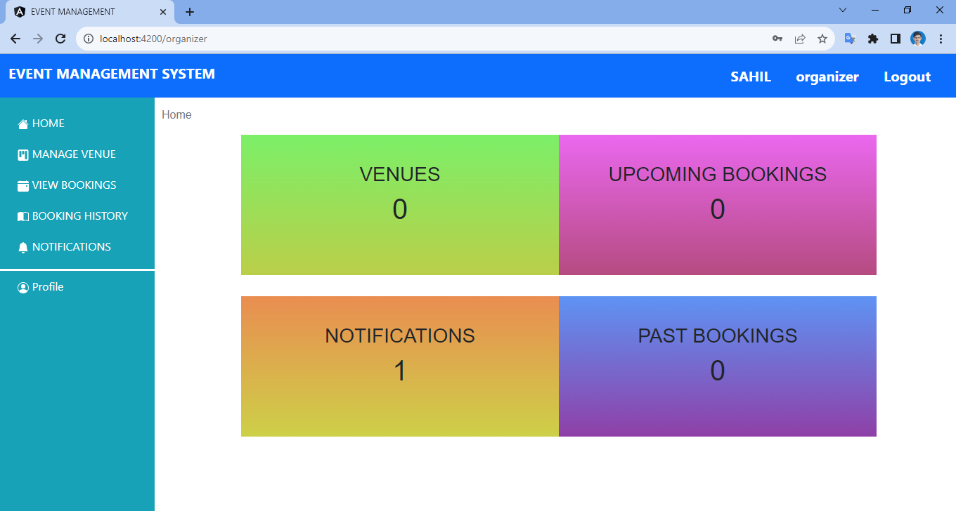
Notes:
so this is the home page for organizer on which you can see there are some numbers which are representing some data related to the organizer such as venues upcoming bookings notifications and past bookings this is the sidebar of the dashboard which is showing option for home ,manage venue, viewed bookings , booking history ,notifications and profile at the top we have navbar which is showing title of the project name and role of organizer and logout option now let's go through each option

Slide 54
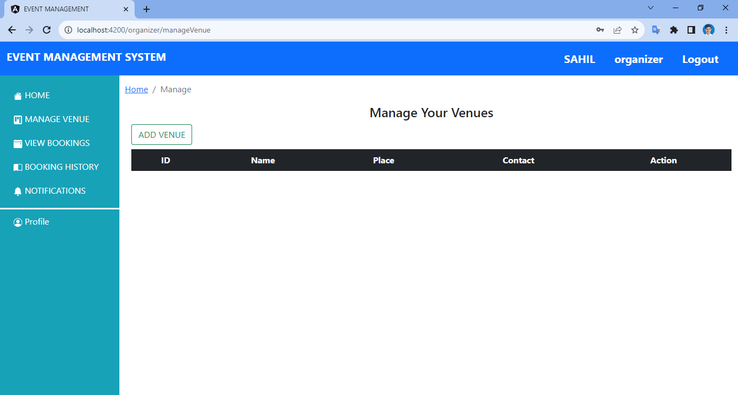
Notes:
first of all i will click on manage menu so you can see a management section is open but currently it is blank because we have not added anything . so here we can add new menu by clicking on this add new button a new page is open

Slide 55
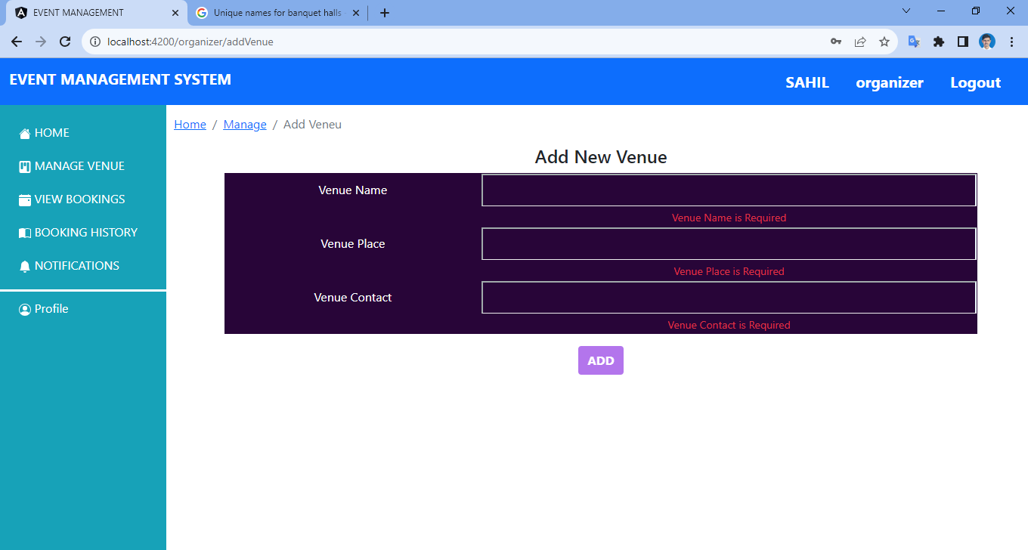
Notes:
If you leave any field blank the add button will be disabled

Slide 56
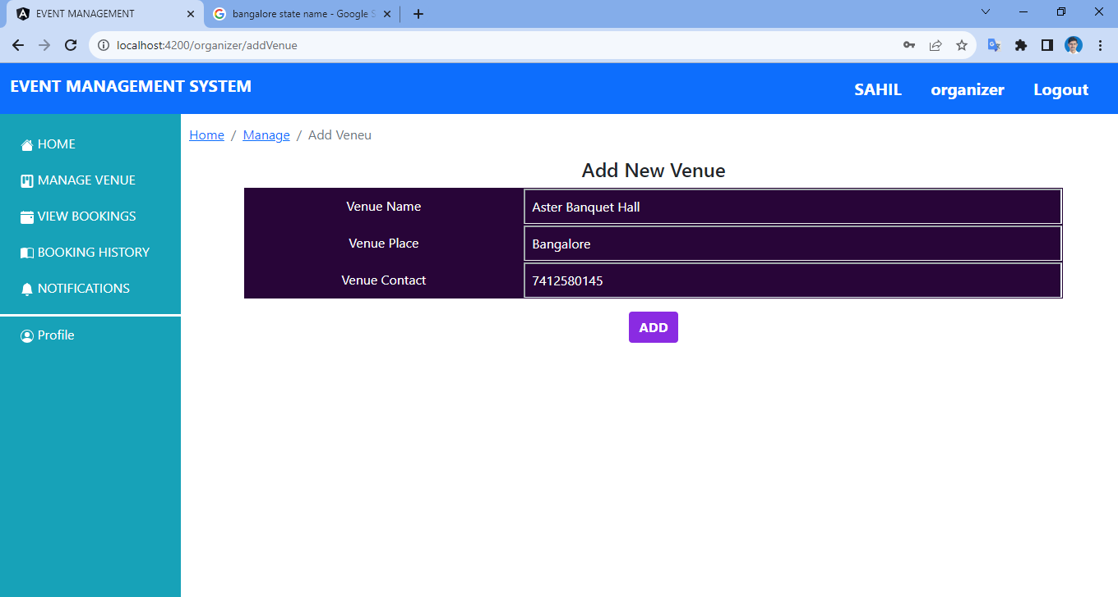
Notes:
Where you have to fill up the venue name, place and contact details and click on add

Slide 57
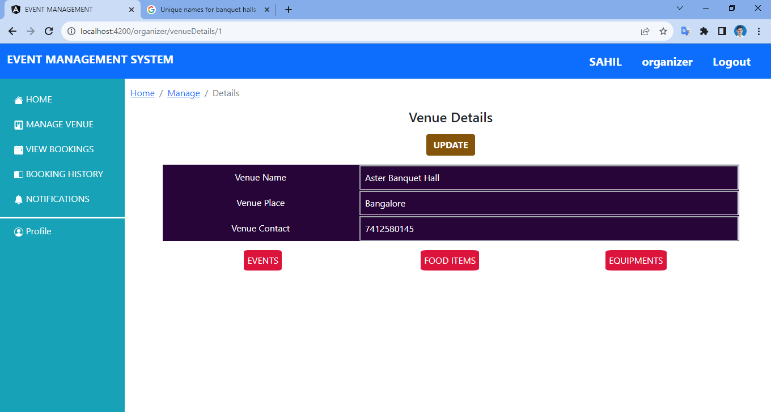
Notes:
After which you have to fill up

Slide 58
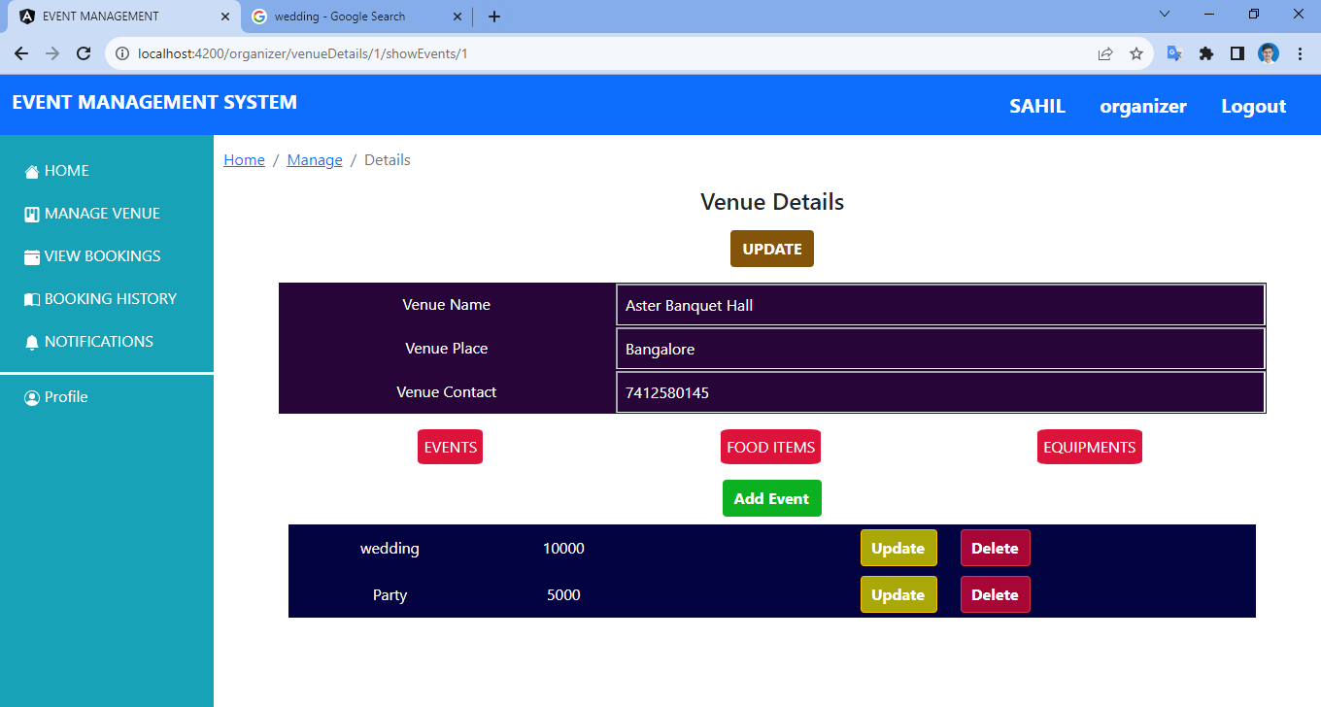
Notes:
The respective event name for example wedding or party and the amount for each event. Also you can update or delete accordingly.

Slide 59
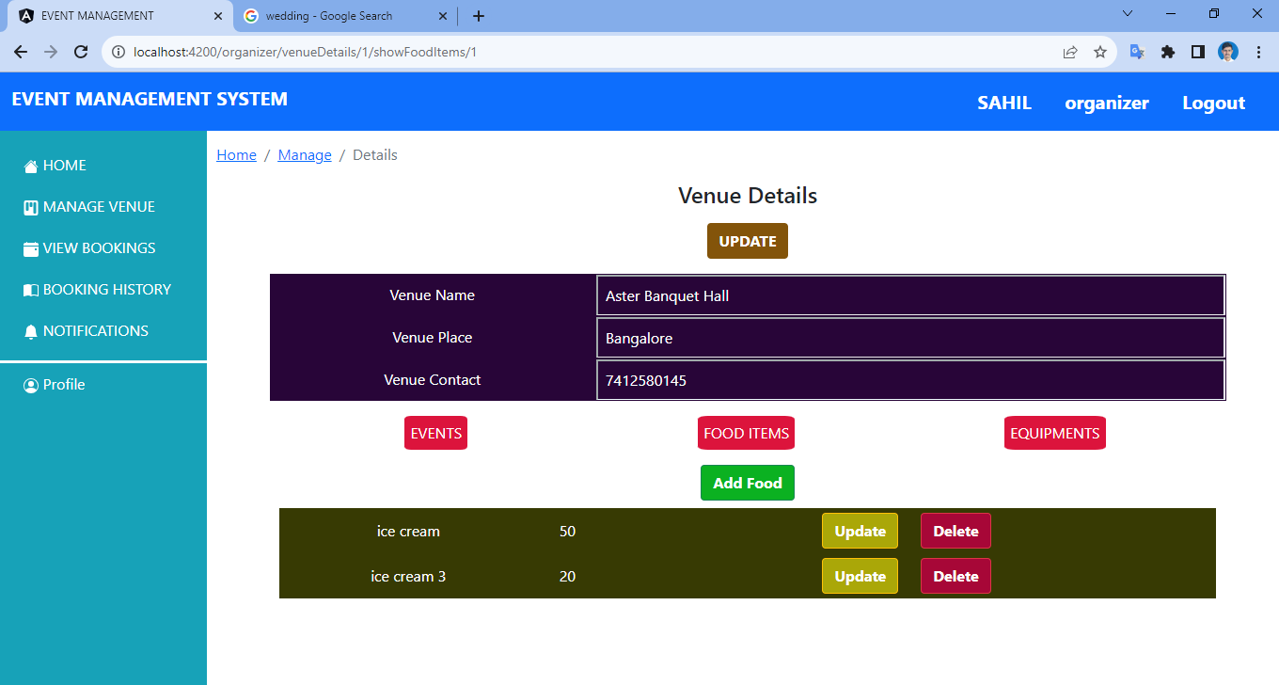
Notes:
Same goes for food items

Slide 60
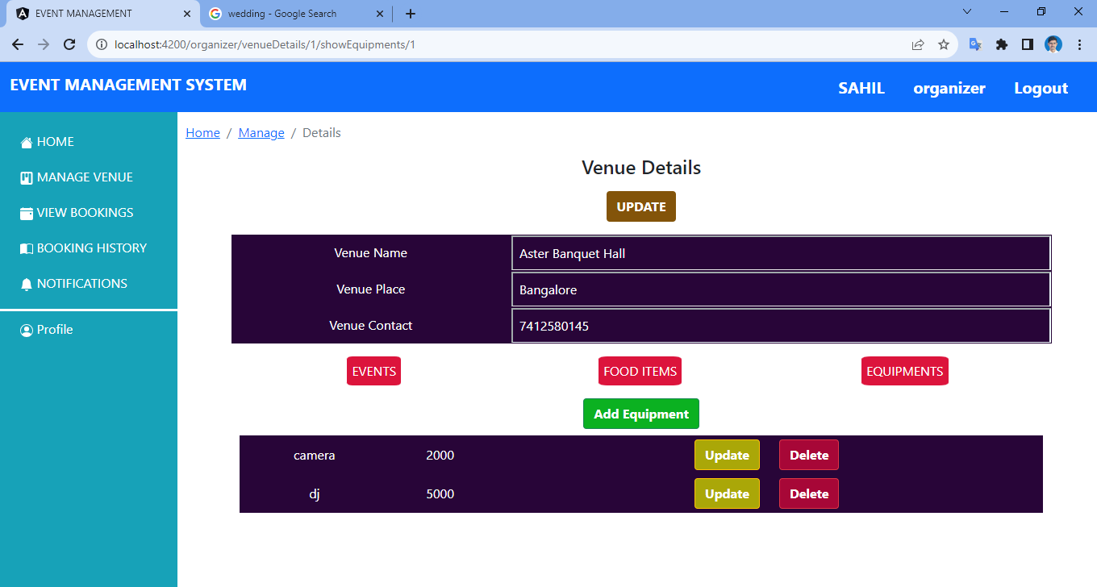
Notes:
And equipments. After that click on the update button on the top

Slide 61
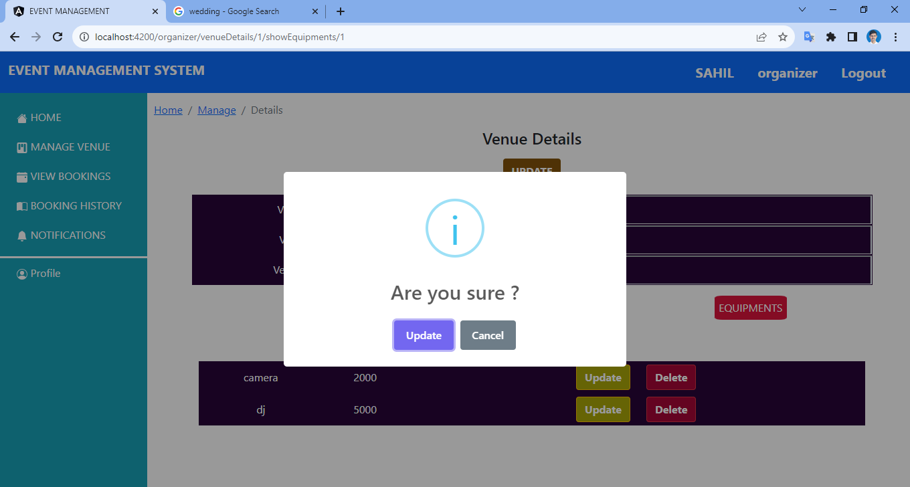
Notes:
A pop up will display asking for confirmation

Slide 62
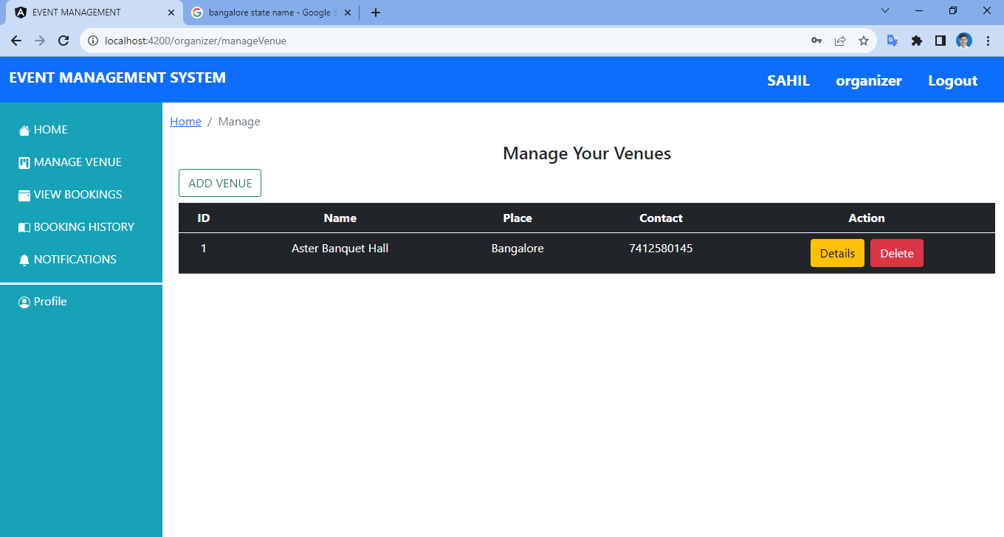
Notes:
After confirmation automatically the venue details will be added.

Slide 63

Notes:
the home page will also be updated after the addition

Slide 64
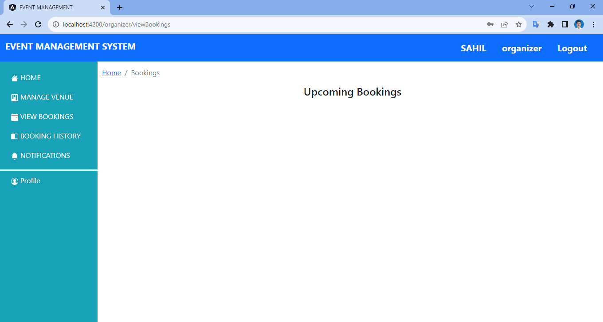
Notes:
If there is any booking you can view it by clicking on view bookings

Slide 65

Notes:
You can also check out your previous bookings

Slide 66
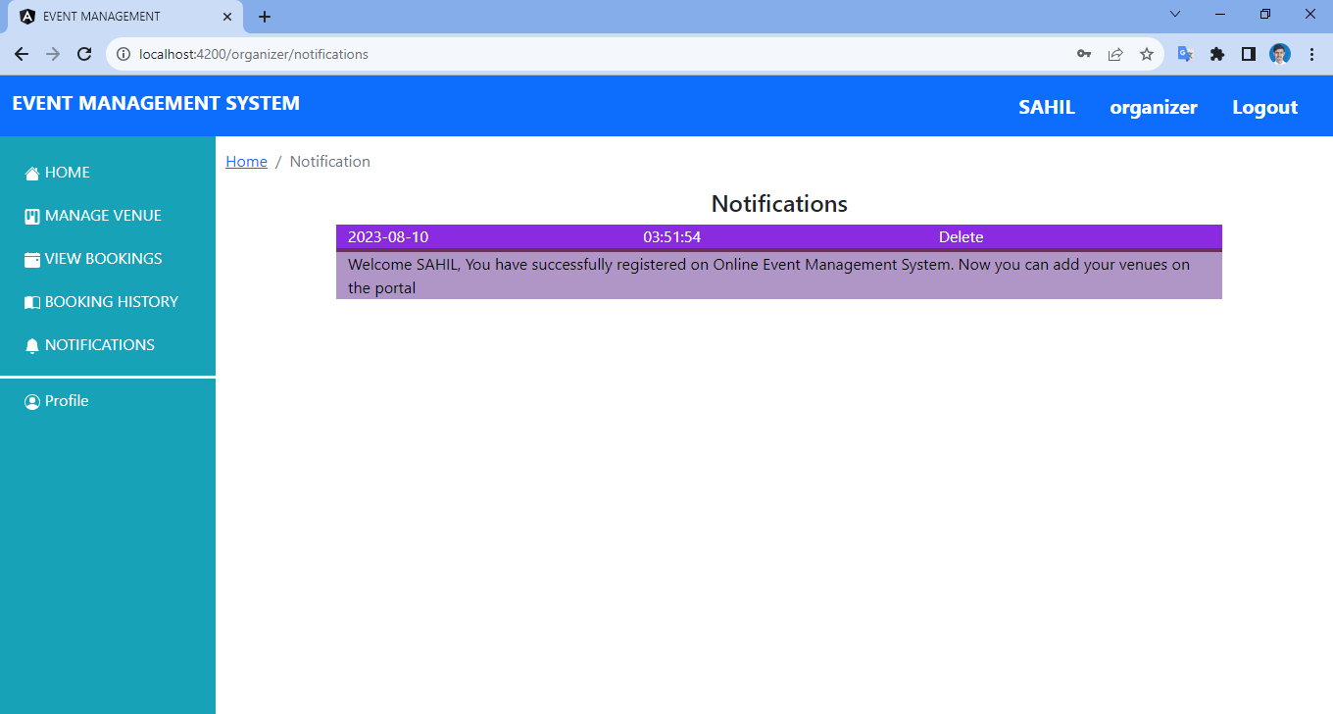
Notes:
If there is an update on bookings or reminder you can view it in the notification panel

Slide 67
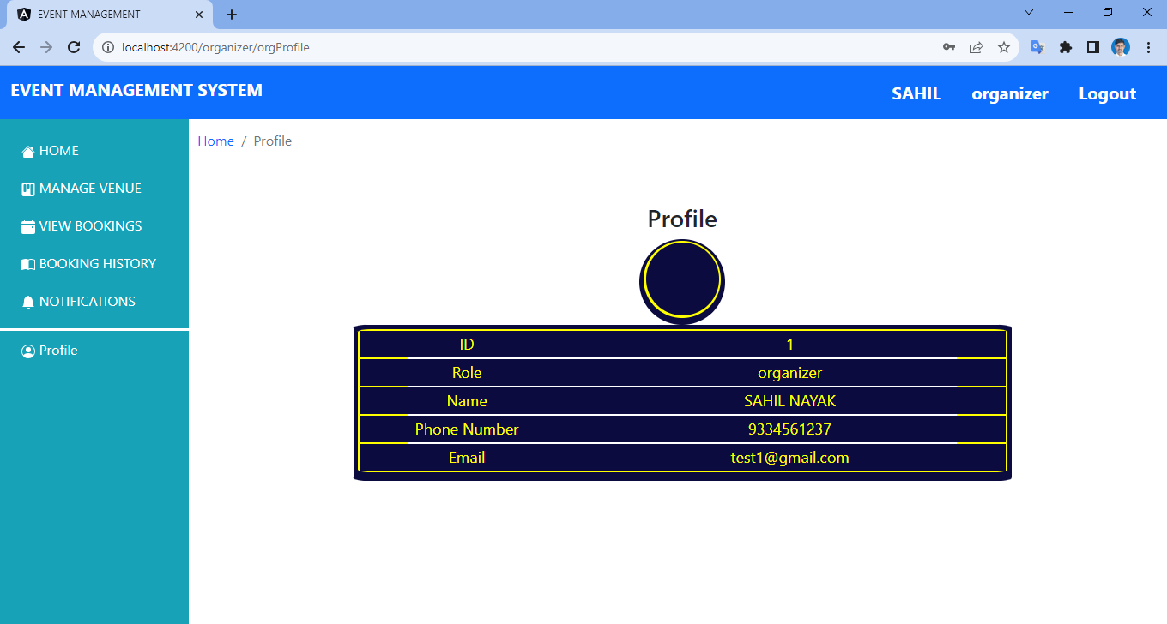
Notes:
The organiser’s profile will be visible on the profile panel

Slide 68
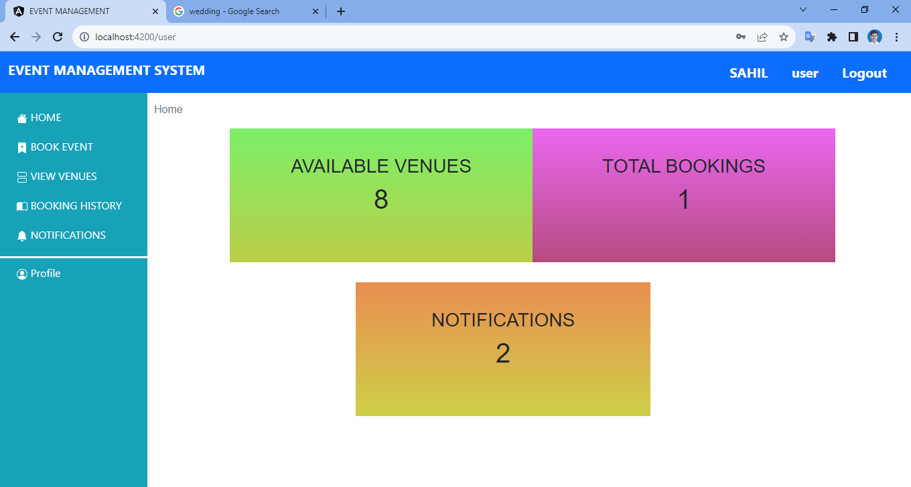
Notes:
The UI is same for the user

Slide 69
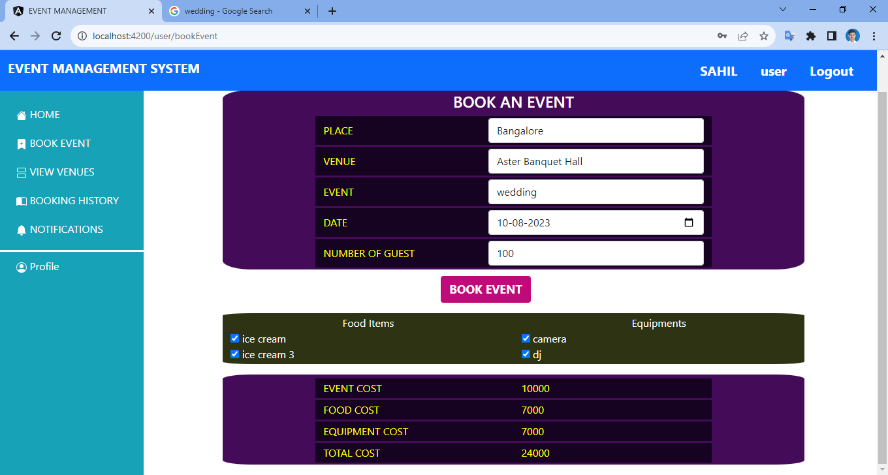
Notes:
While booking for example if you choose Bangalore as the place it will automatically show you the available venues. Also past dates are not supported . The cost of food and equipments are automatically added as per the number of guests. After completing click on book event button

Slide 70
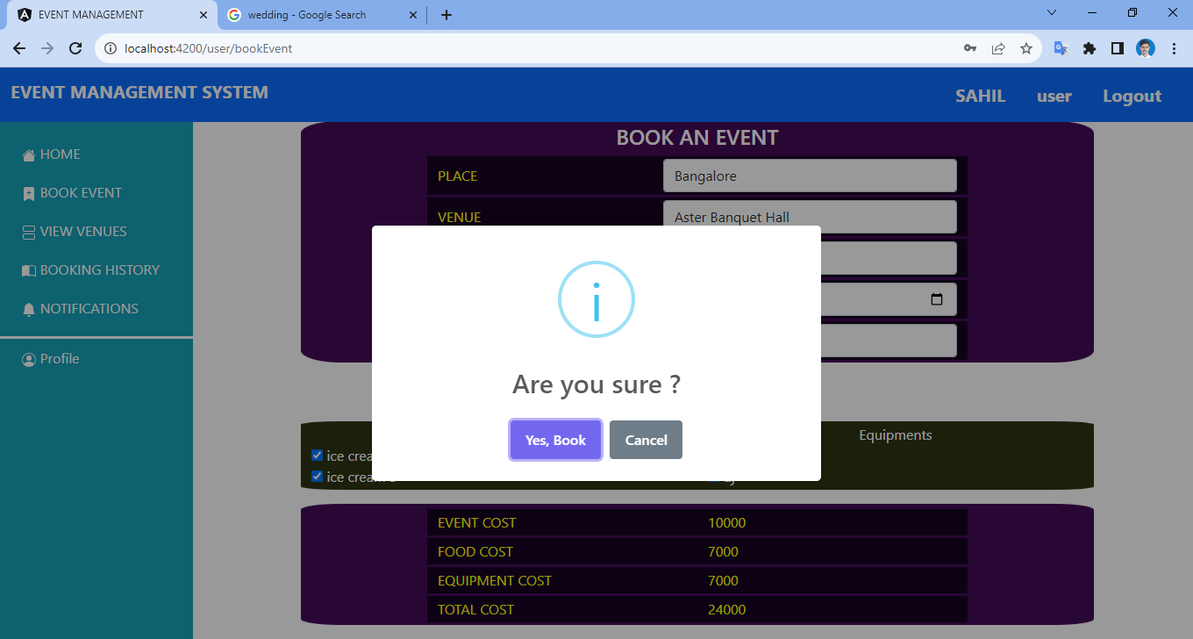
Notes:
Pop up will ask for confirmation

Slide 71
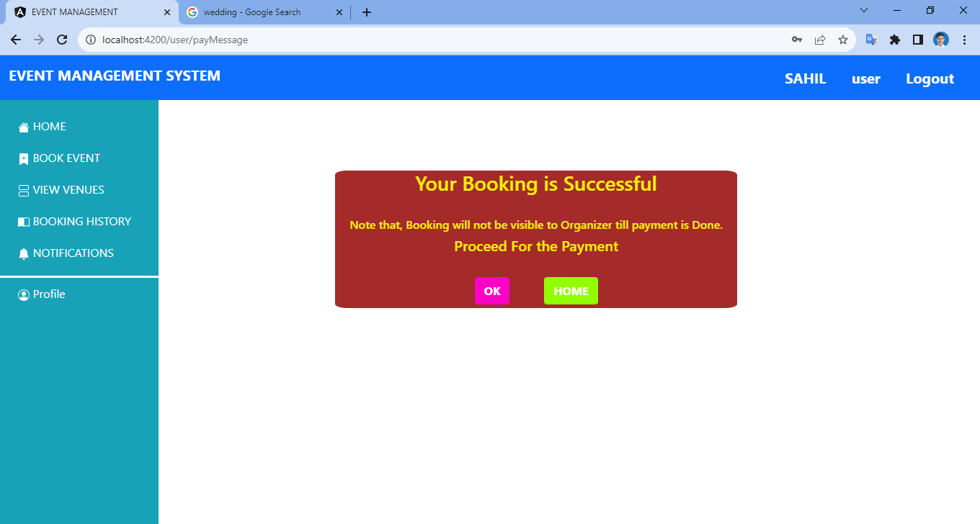
Notes:
Now your booking is successful but you will see a messaging stating that the booking will not be visible to the organiser until the payment. so after clicking on ok you will be redirected to

Slide 72
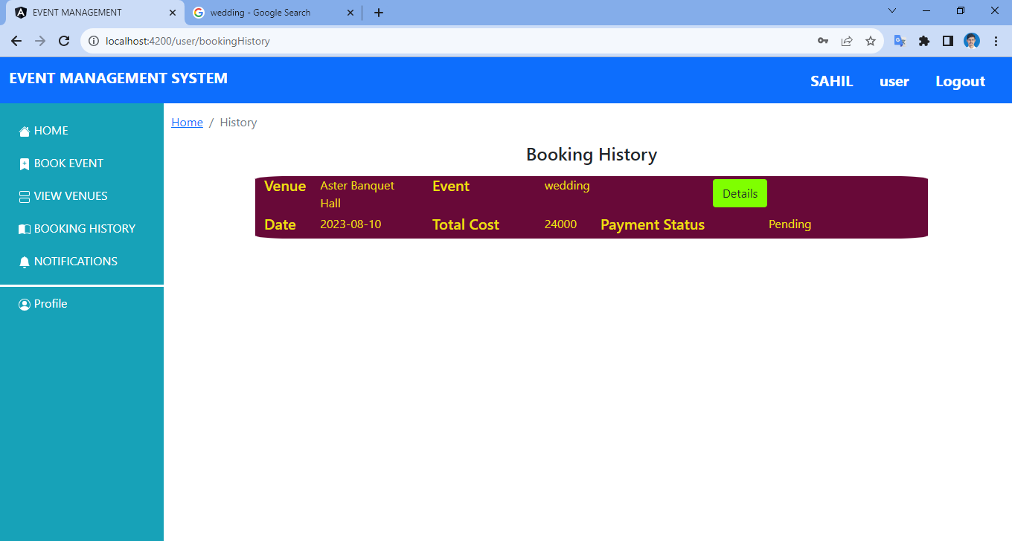
Notes:
The booking history page . So now as you can see the payment status is pending so simply click on the details button

Slide 73
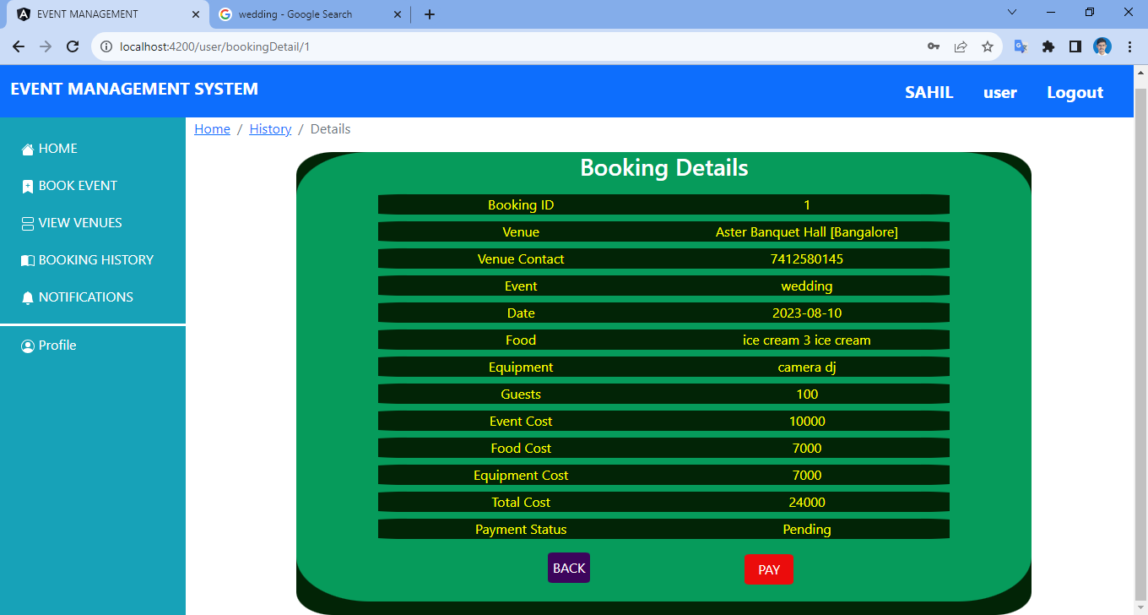
Notes:
After which you will be redirected to the booking details page where you can see all the booking details. Now click on pay button for payment

Slide 74
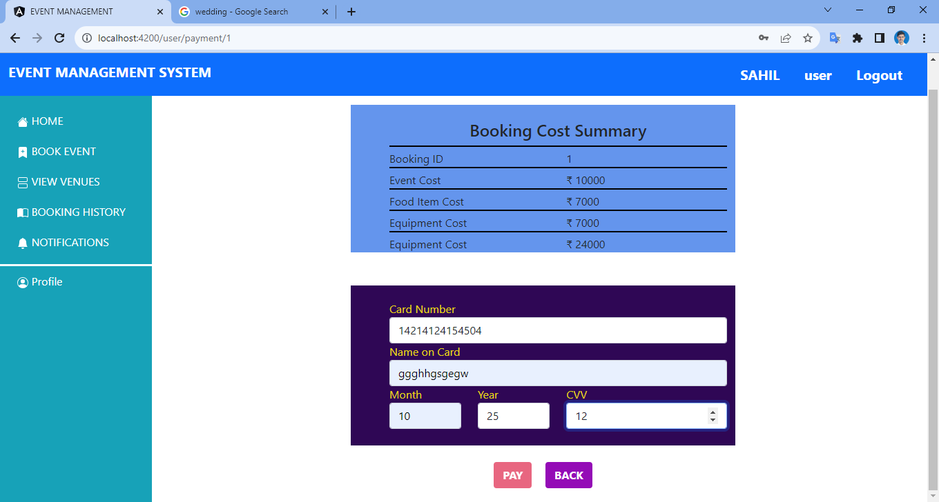
Notes:
Here on the payment page the card number field can only support 14-16 digit number also the letters in the name field should be minimum of 6 letters. if there is a mistake the pay button will be disabled

Slide 75
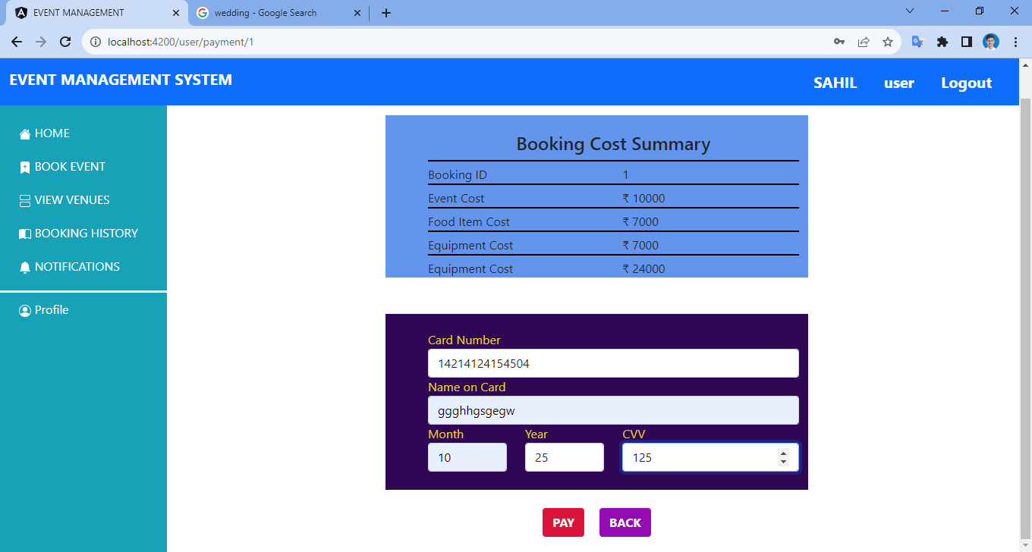
Notes:
After correctly filling up the details the pay button will be enabled

Slide 76
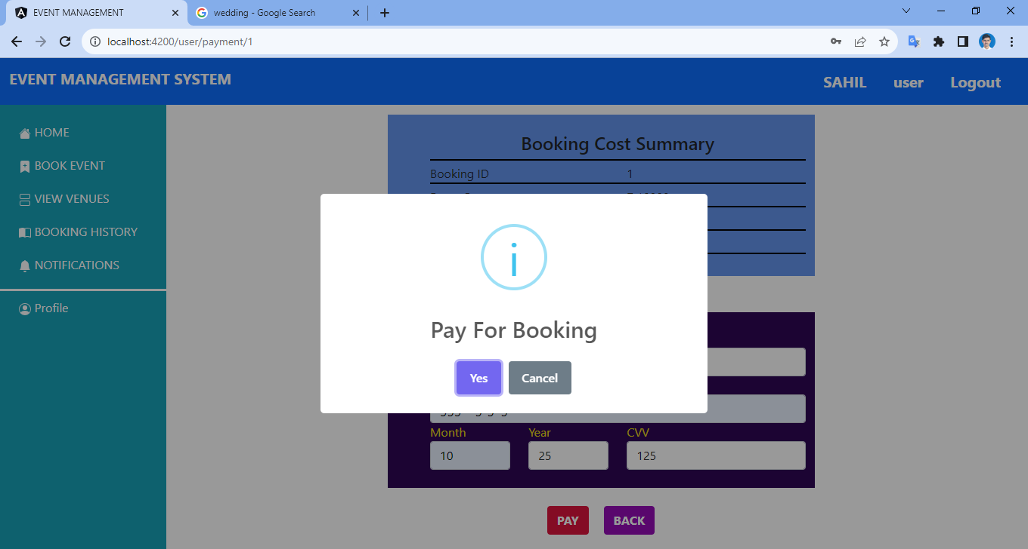
Notes:
A pop up for confirmation is displayed

Slide 77

Notes:
Second pop up for payment processed will be displayed

Slide 78

Notes:
Now on the booking history page the payment status is shown as processed

Slide 79
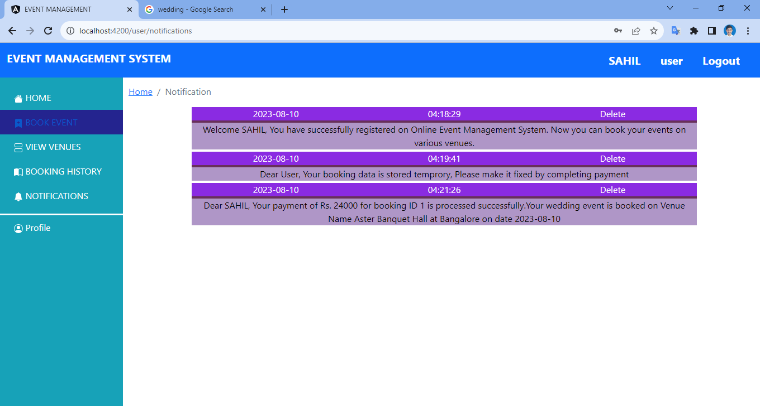
Notes:
All the updates will be visible on the notification panel

Slide 80
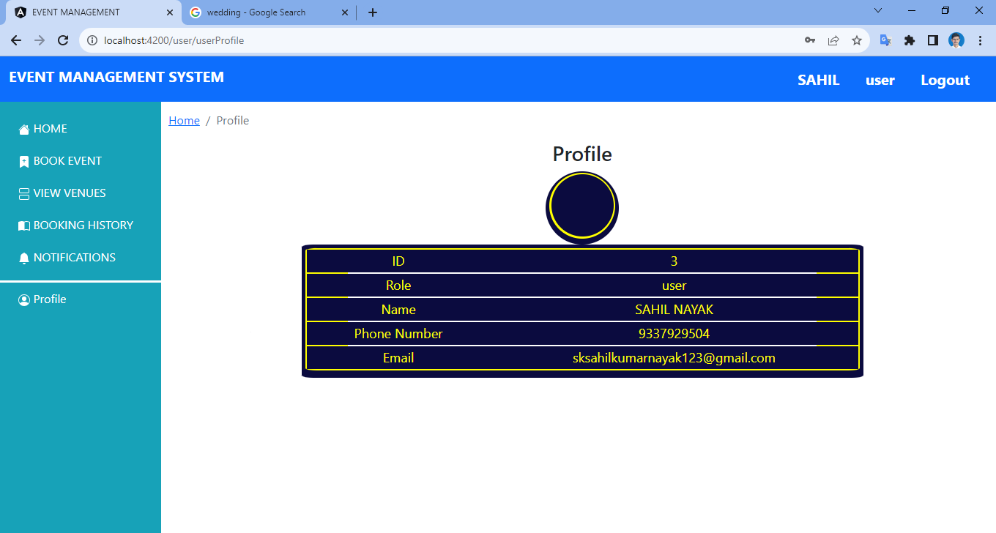
Notes:
The user’s profile will be visible on the profile panel

Slide 81
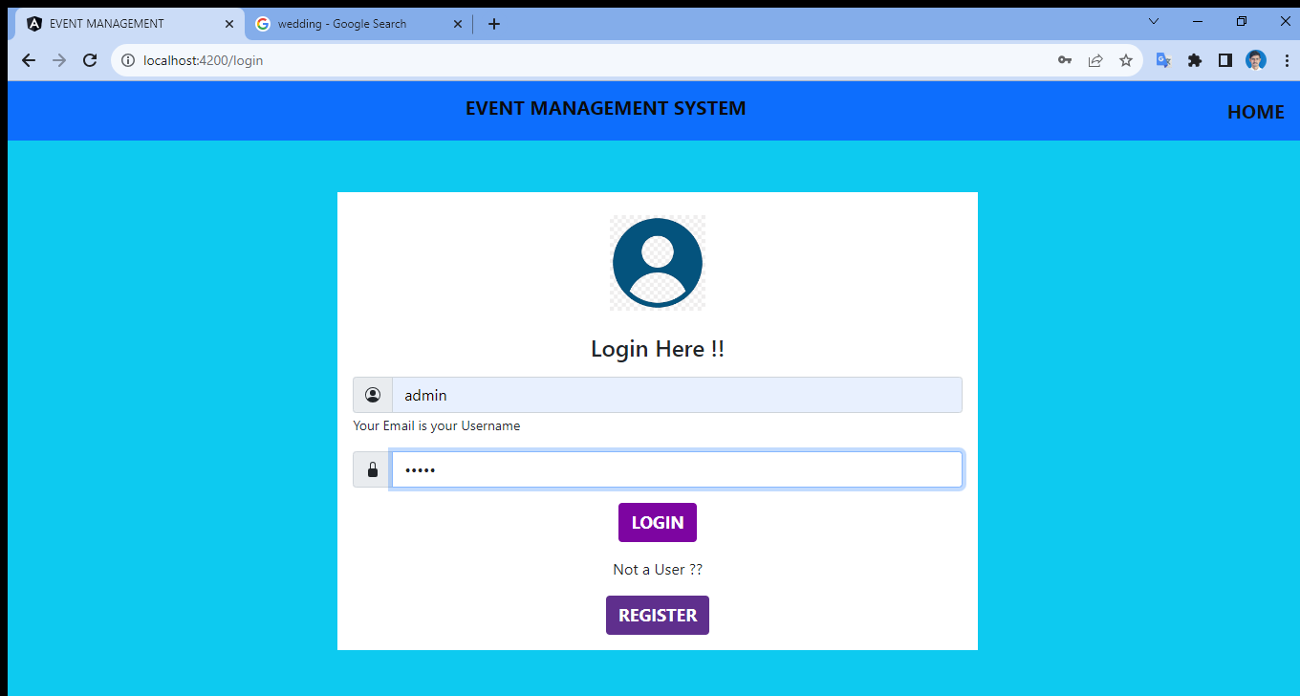
Notes:
Now admin has to login

Slide 82
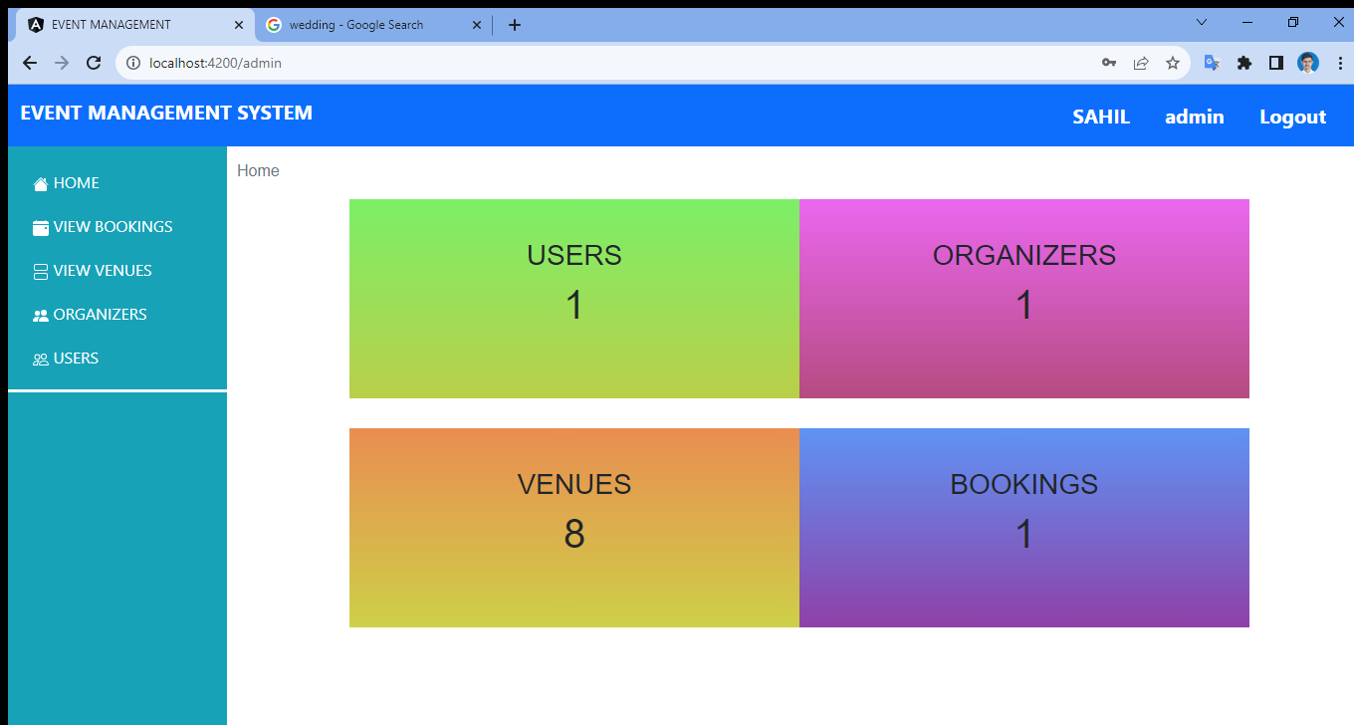
Notes:
Here admin can see the users, organisers, venues and bookings

Slide 83
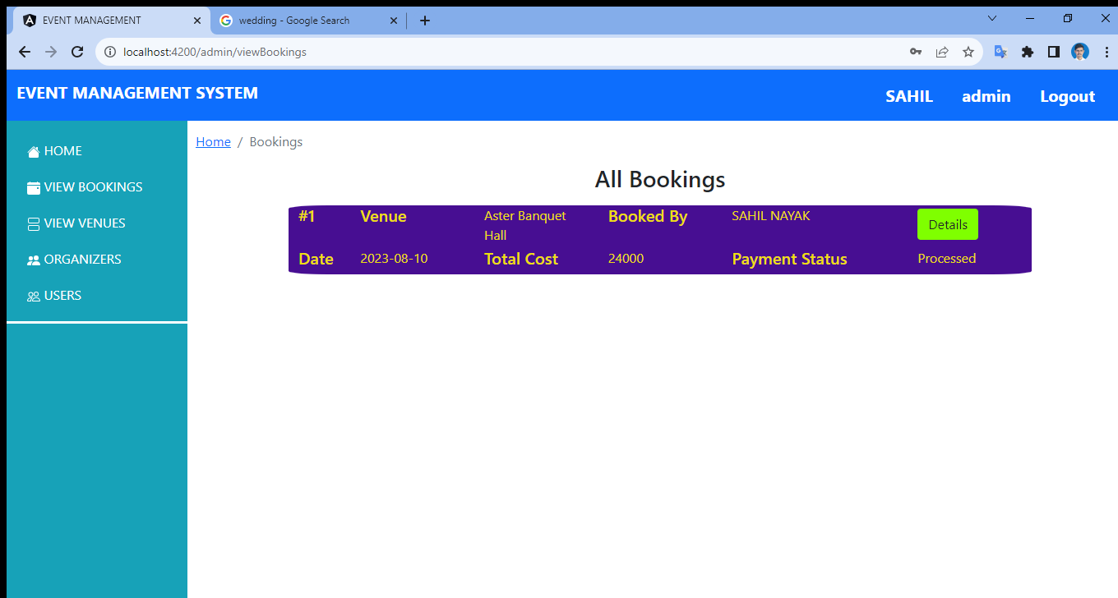
Notes:
Also the payment status can be checked here

Slide 84
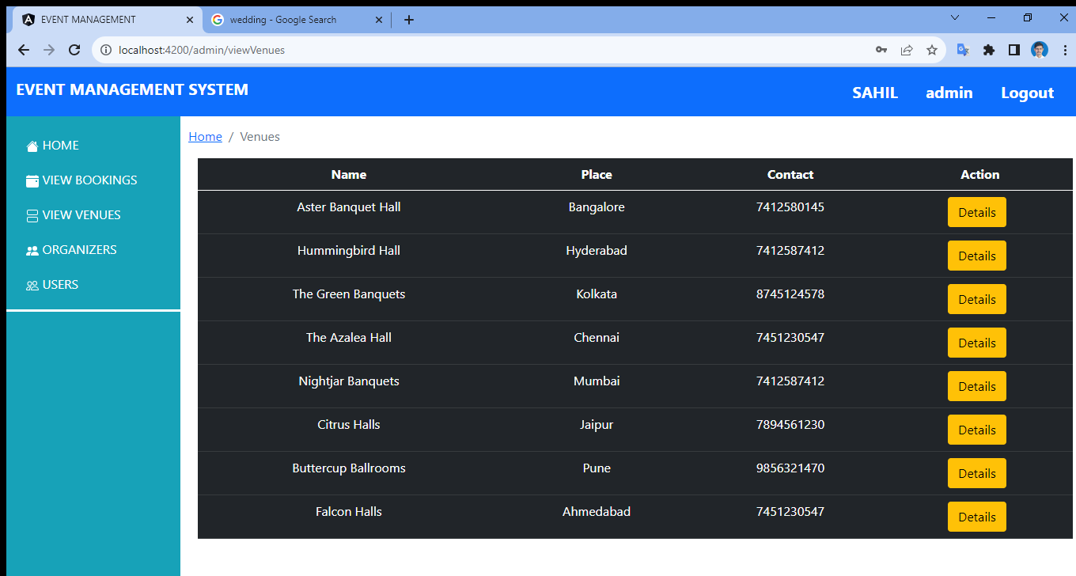
Notes:
Admin can also check how many venues are available

Slide 85
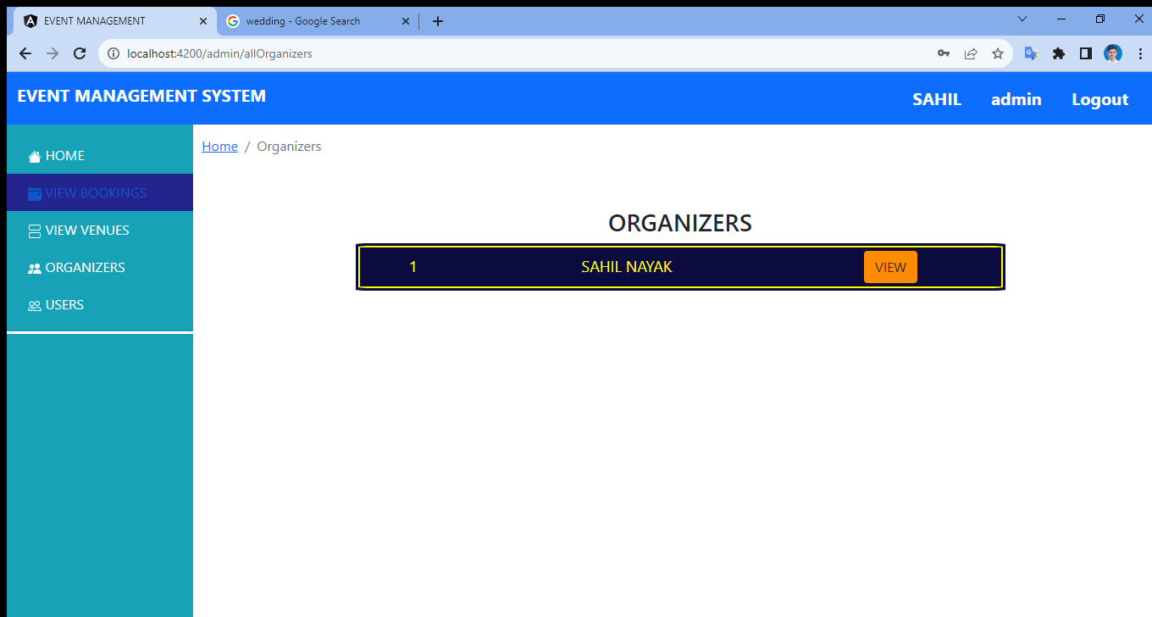
Notes:
Admin can also check the number of organisers available

Slide 86
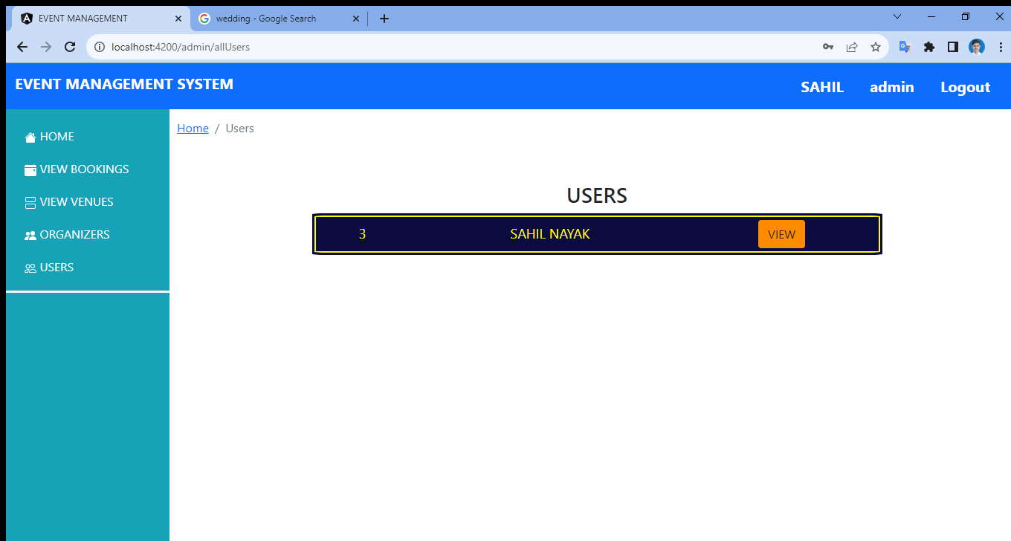
Notes:
Same can be checked for the number of user available

Slide 87
THANK YOU
Notes:
So now we come to an end of this project. Thankyou you all for taking a look at my project and bearing with me

Slide 88
THE END

